Slide 1

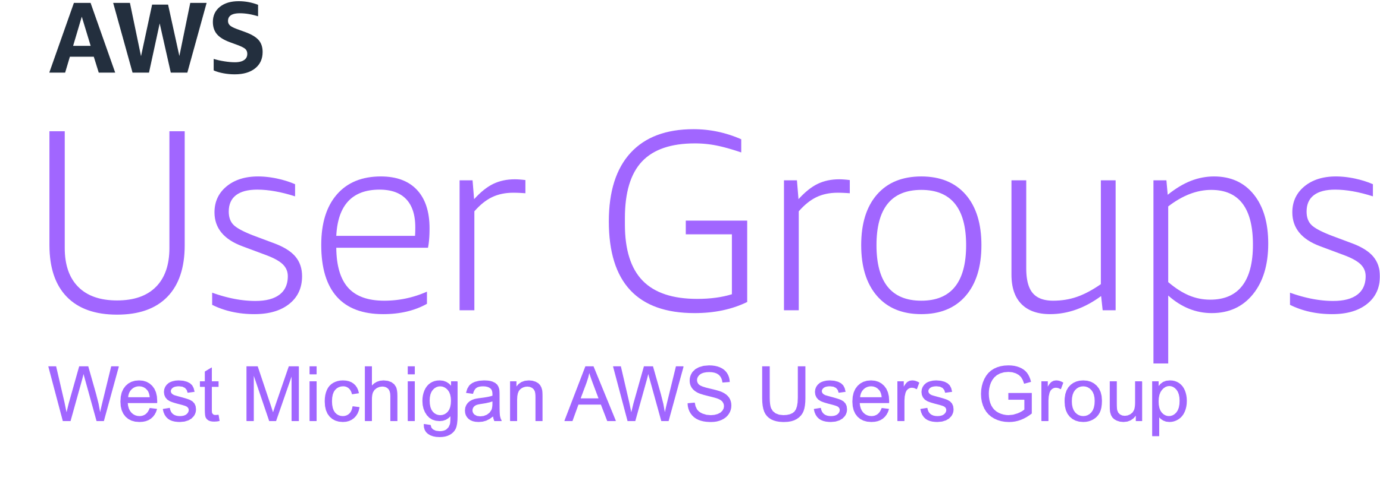

Automating Pull Requests With
CDK & BedRock
March 2024

Slide 2


Introductions
Trent Nielsen
Justin Wheeler
Enterprise Architect @ PXG
Cloud consultant
Husband and Father
Software Developer @ Bravo LT
Cloud Builder
Holder of all the certs
AWS Hero

Slide 3
User Group Updates
New Organizer
2024 Schedule
User Group AWS Account(s)
AWS Account Credit Raffle
Mitten Project
2024 Schedule

Slide 4

Current
PrBot
Upcoming
Betrayal Buddy
WMAUG Website
WMAUG AWS Account Infrastructure rollout

Slide 5
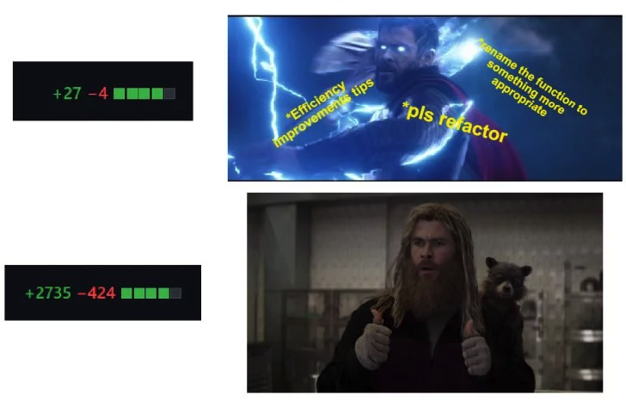

Slide 6
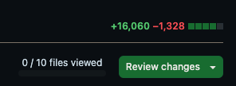
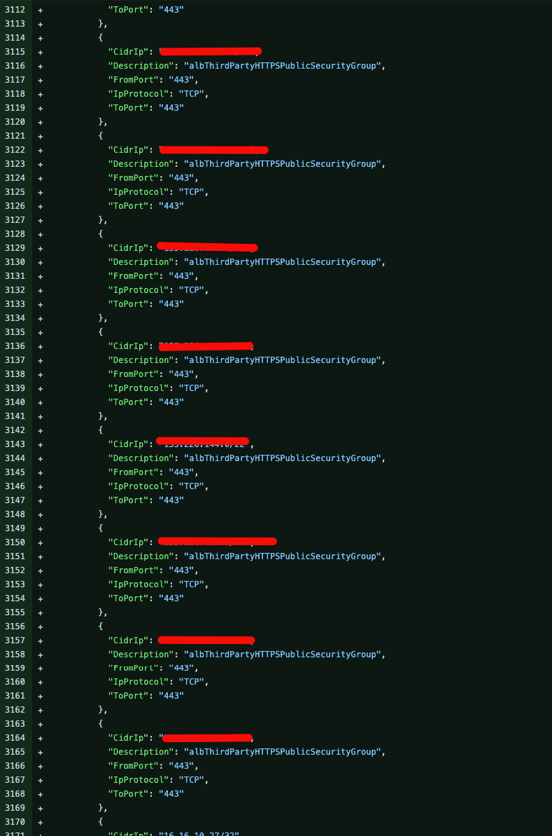
Look Familiar?

Slide 7
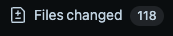
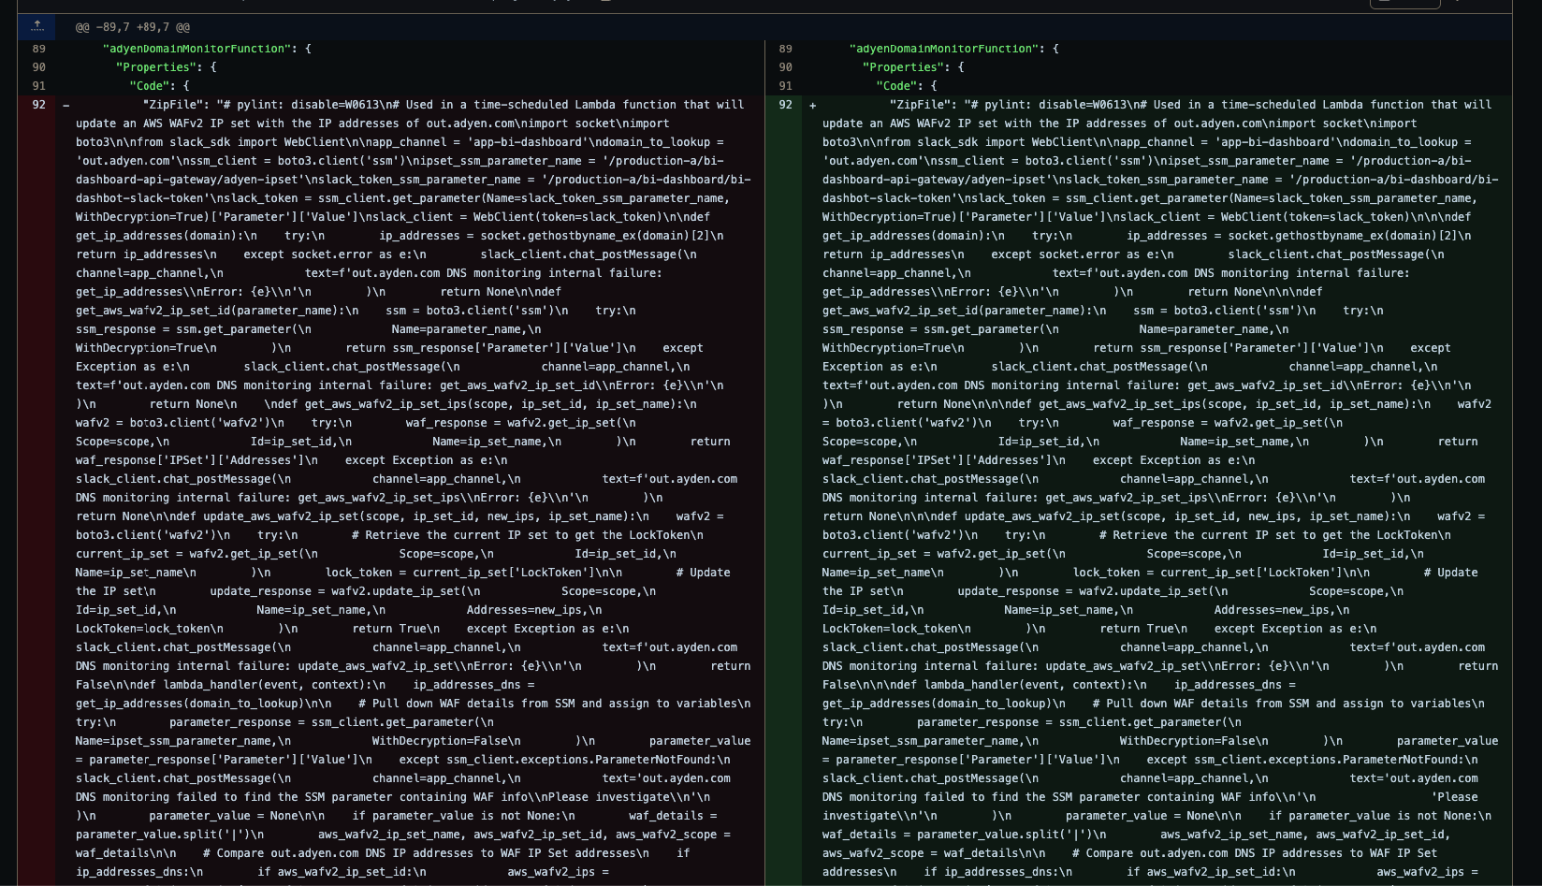
Look Familiar?

Slide 8
PR Problems
Time-consuming, especially for routine changes
Unintended changes can be missed in large PRs
Automatically summarize changes
Automatically nitpick for style/formatting issues

Slide 9
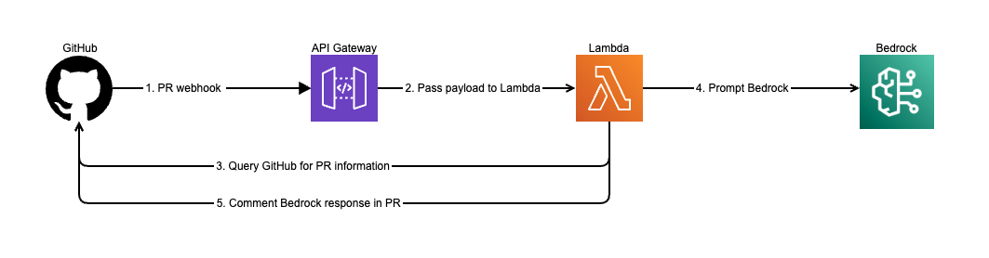
Architecture

Slide 10
CDK Placeholder

Slide 11
CDK Things that go here
Architecture Review
CDK project language
DRY
Imperative
Layout
Assets
Lambda
Layers
AWS Supported

Slide 12
CDK Resource Info
API gateway
Lambda

Slide 13
Alternative overview
- Lambda URL as alternative

Slide 14
App Logging
- API Gateway can be enabled for access logs
- Enabled for Lambda execution logs
- Bedrock prompts are logged

Slide 15
Bedrock
Claude Model access – must be requested in the console, no provisioned resources required.
Proposed solution used Claude 2.1

Slide 16

GitHub

Slide 17

More than just a code repo
Actions
WebHooks
Secrets

Slide 18
Actions Automation
Build Environment
Install AWS-CDK
Setup Python
Configure AWS credentials
Build Assets
Layer
Lambda
CDK Synth
CDK Deploy

Slide 19
Webhooks
Configured Per Repo
Event Triggers
Enabled for PrBot

Slide 20
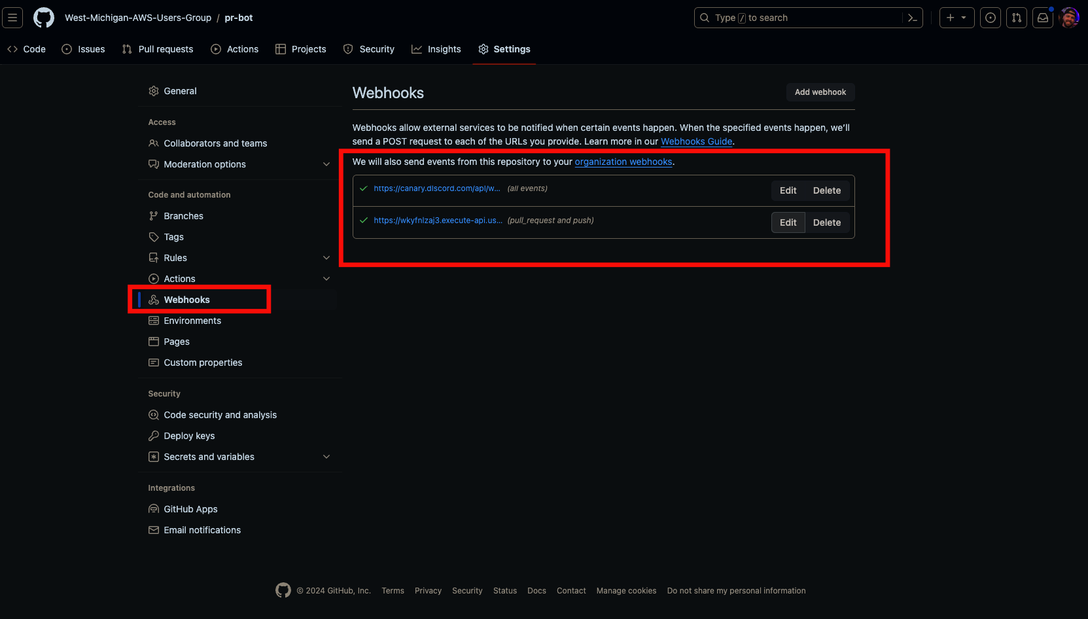
Webhooks

Slide 21
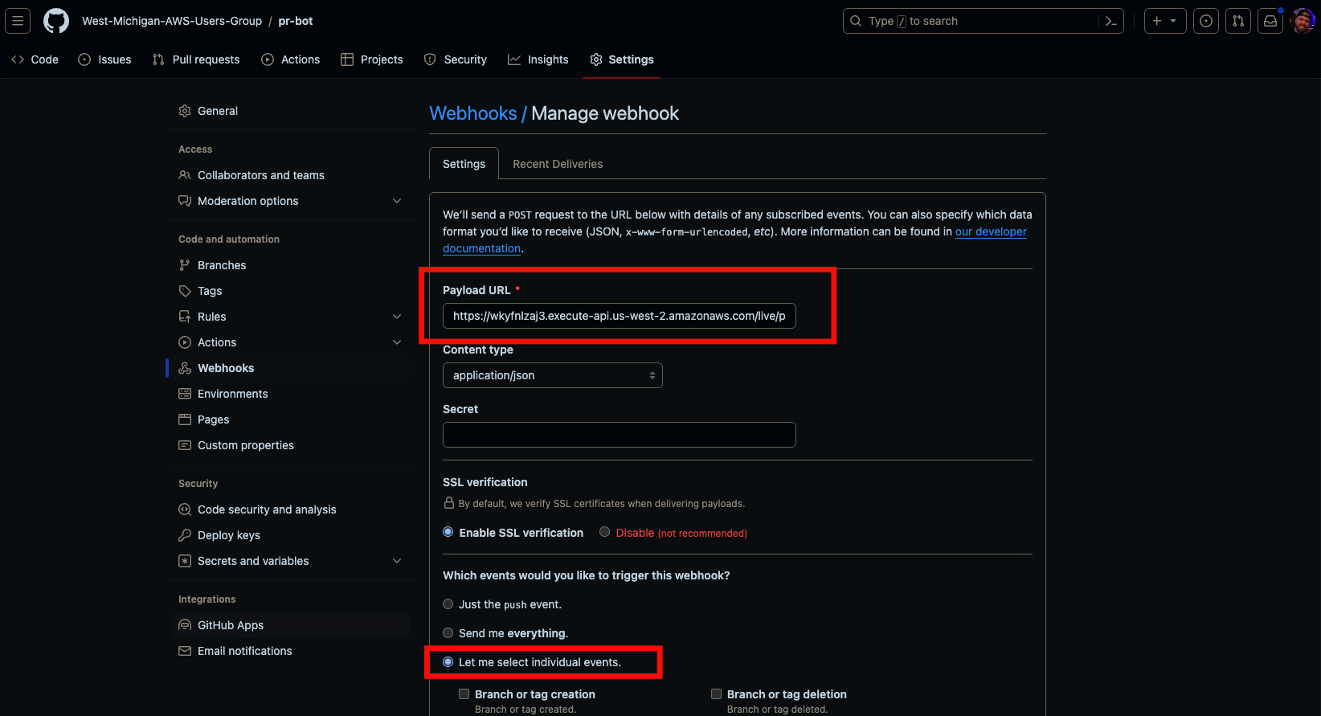

Slide 22
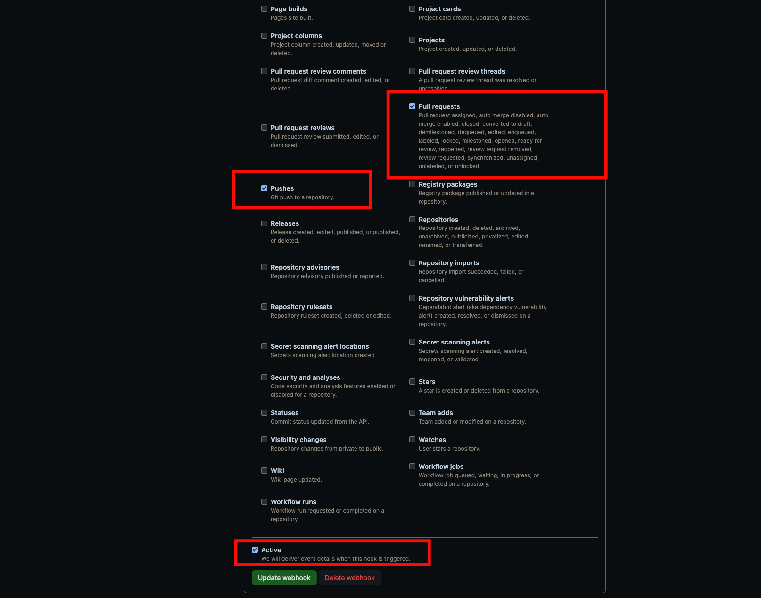

Slide 23
Secrets
Deploy user
Github Token

Slide 24
CI Secrets
Service Account Keys
This provides deploy keys for Actions
Configured in GitHub

Slide 25
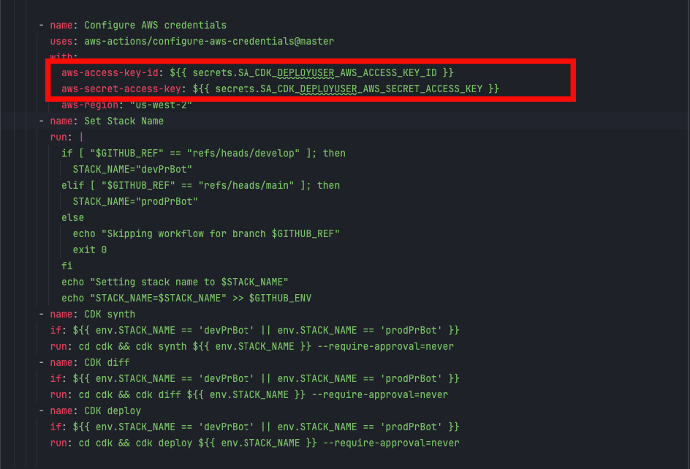
CI Secrets

Slide 26
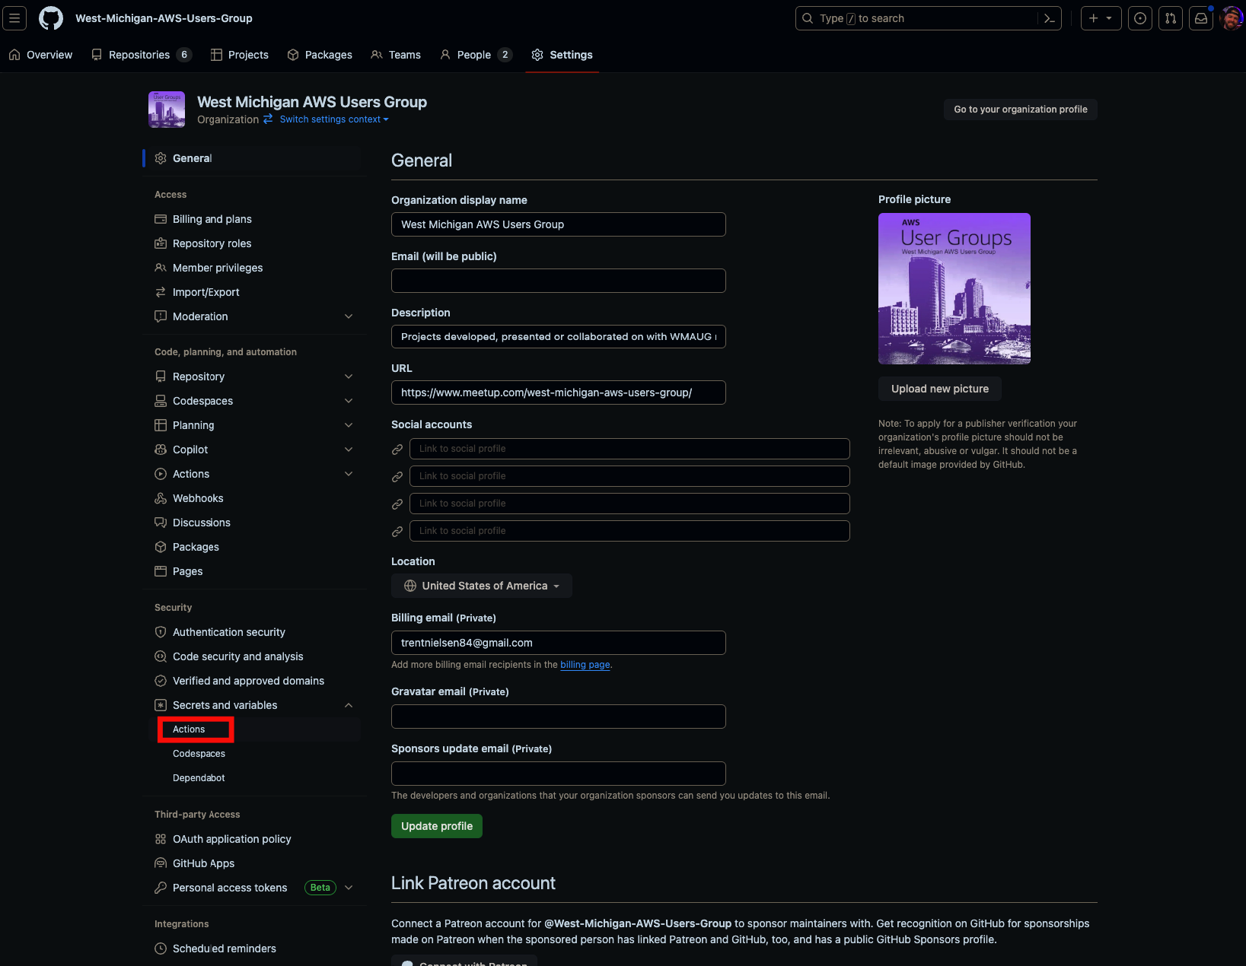

Slide 27
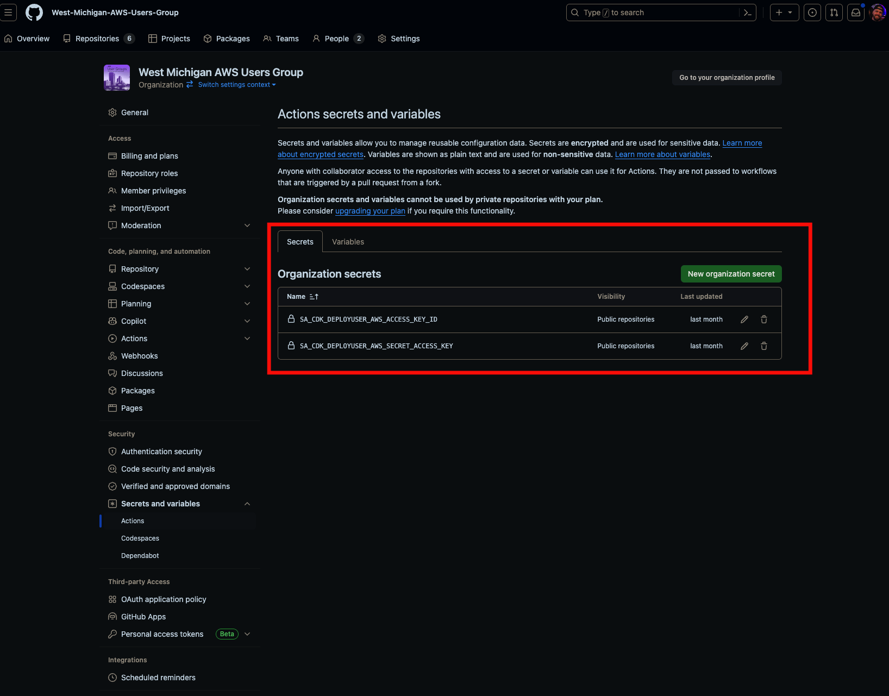
Secrets

Slide 28
App Secrets
AWS Secrets
Code Reference

Slide 29
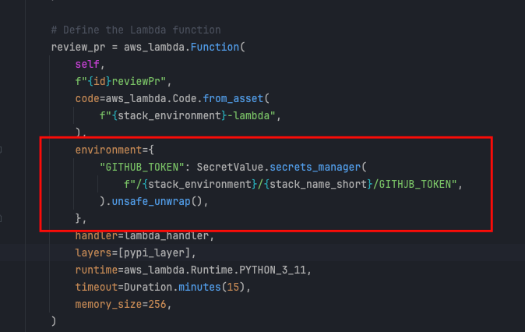
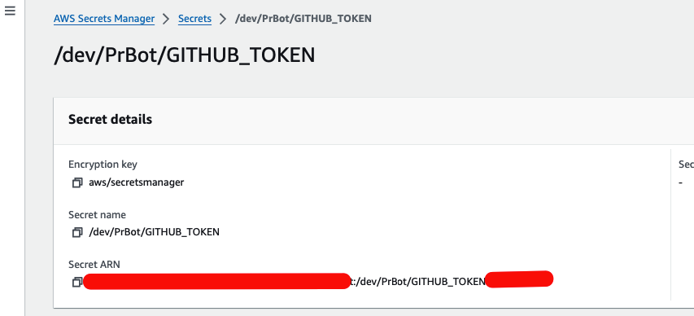
App Secrets

Slide 30
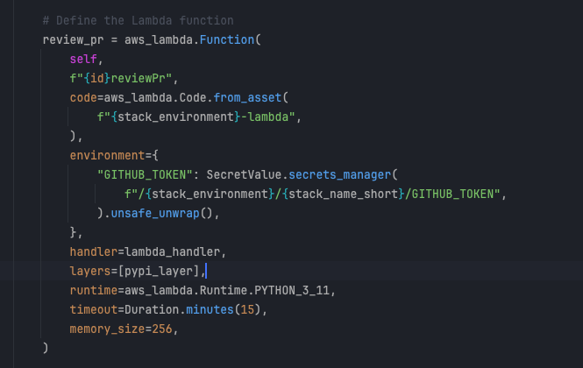
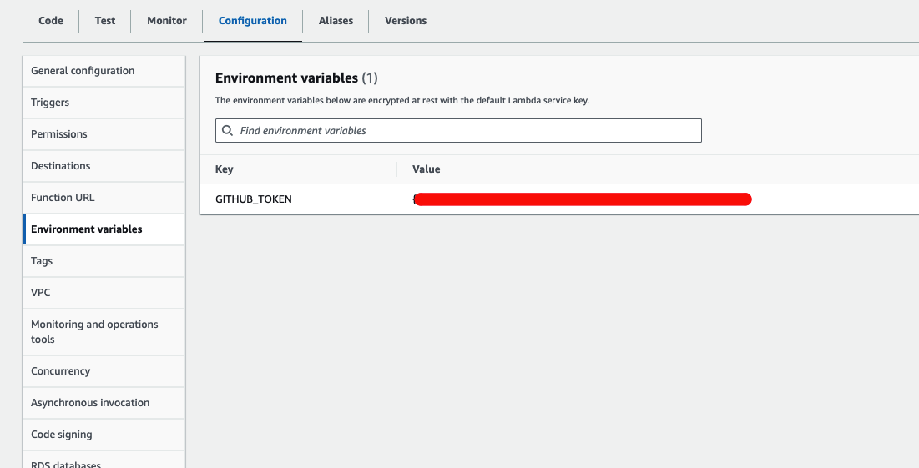
Secrets (Unsafely Unwrapped)

Slide 31
Lambda Secrets
Pulled from AWS Secrets Store
Rendered at time of synthesis

Slide 32
Actions Config Review

Slide 33

Lambda + Bedrock Code Review

Slide 34
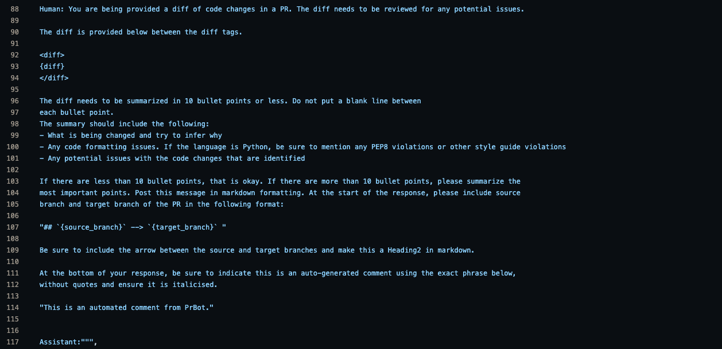
Prompt

Slide 35
Examples

Slide 36
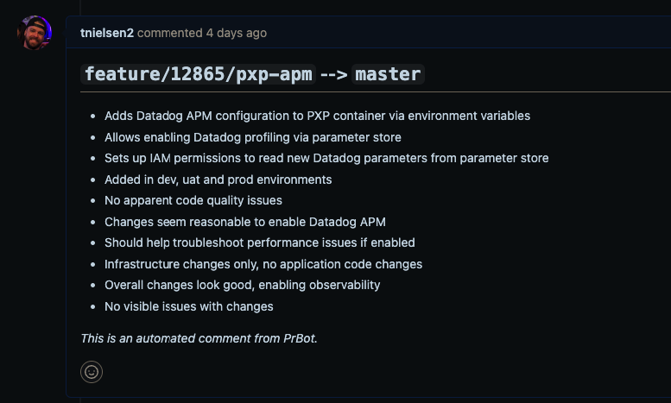
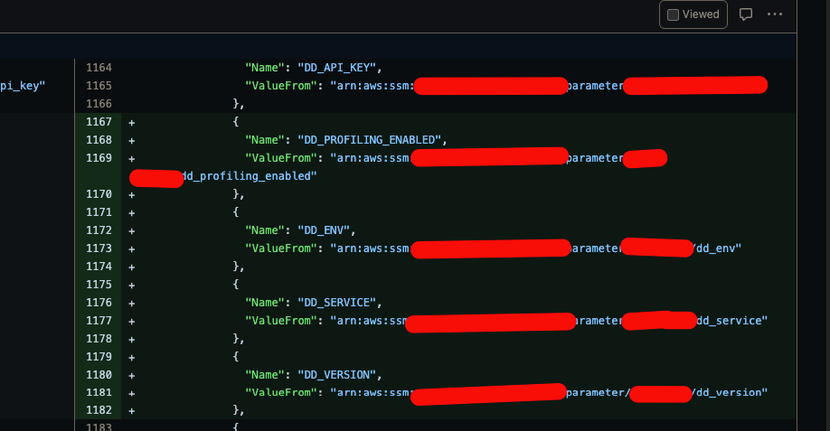
Add Environment Variables

Slide 37
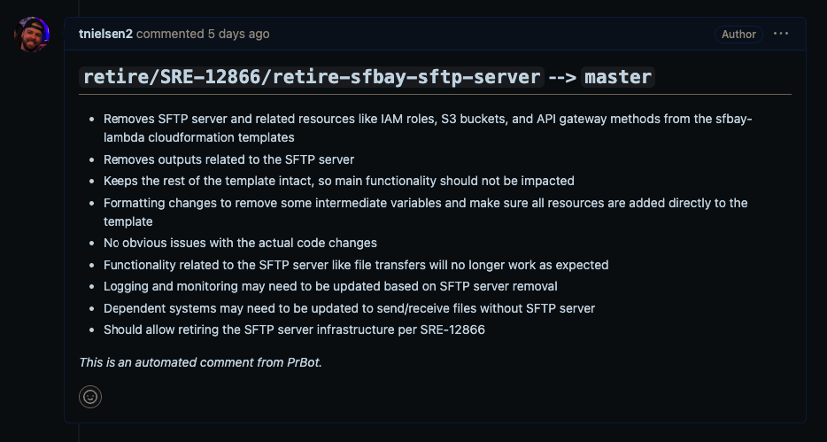
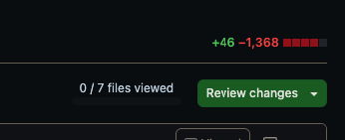
Stack Retirement

Slide 38
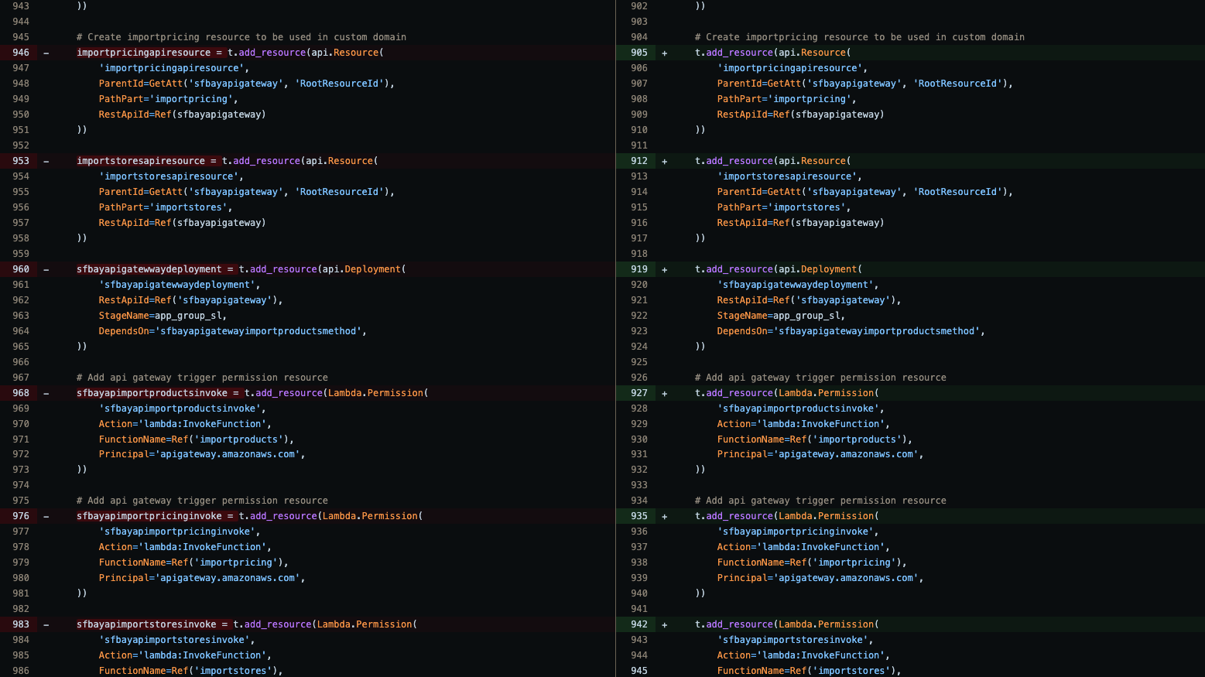
Stack Retirement (Continued)

Slide 39
Title Slide
Cost
AWS User Groups
39

Slide 40
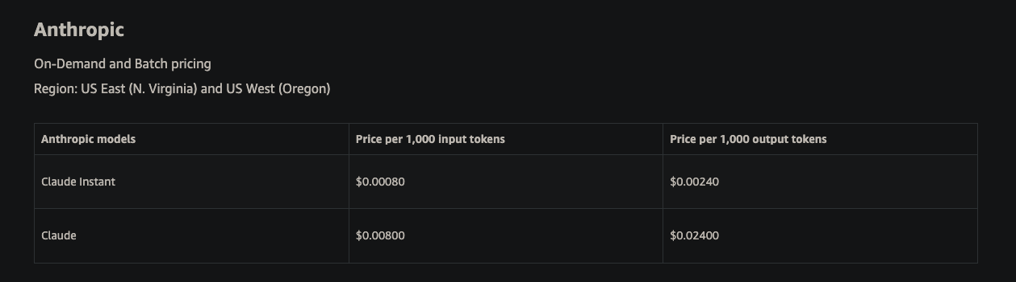
Cost

Slide 41
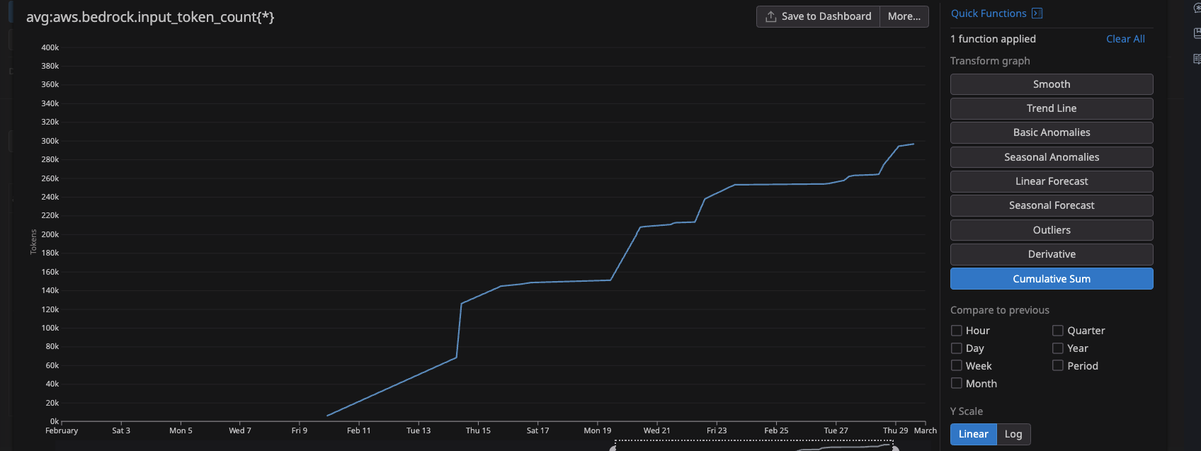
Usage

Slide 42
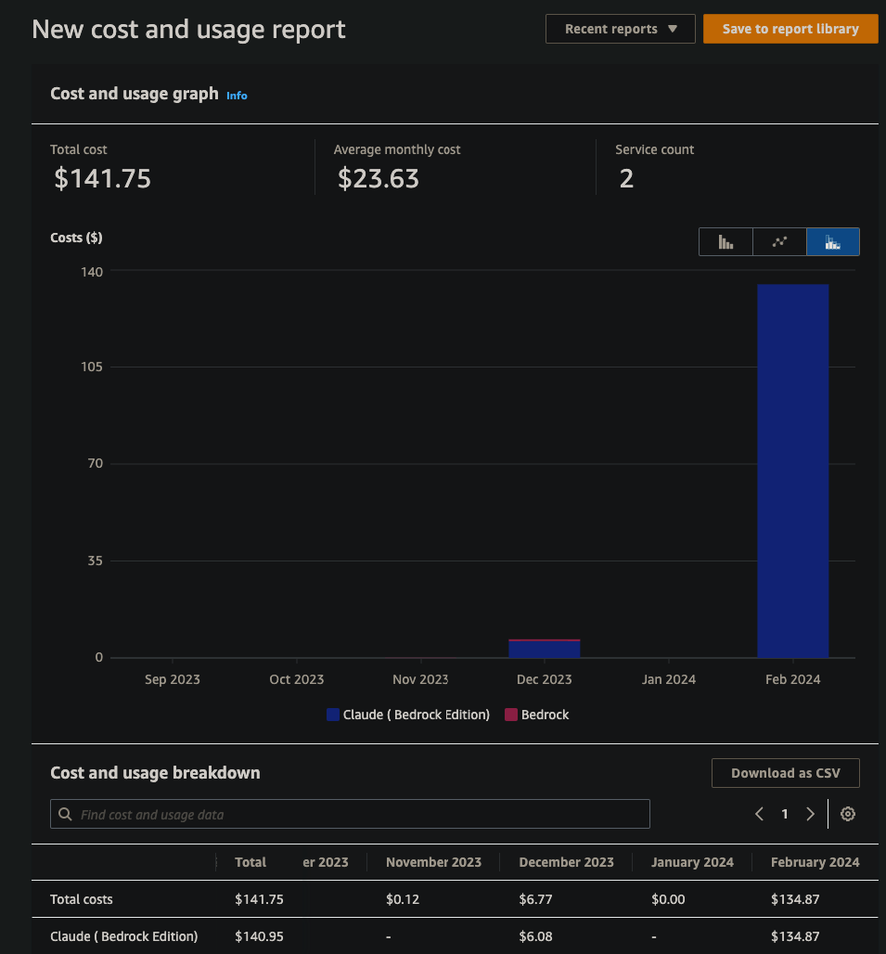
Cost

Slide 43
Title Slide
Improvements
AWS User Groups
43

Slide 44
Improvements
Layer
Layer build process and version pinning
Unique per environment for future testing
Pin to known good versions to prevent unexpected layer changes
Tests
Implement CDK tests
Permissions
Migrate personal access token to service-account user
Trigger on
Trigger on-demand w/ label usage, rather than on every PR
Update
Update CDK to have Lambda fetch values from Secrets instead of injecting as an environment variable
Auto
Auto-tagging after approval (for 2x auto-reviewer tagging)

Slide 45
Title Slide
Raffle
import random def select_random_index(string_list): if not string_list: print("Error: The list is empty.") return None random_index = random.randint(0, len(string_list) - 1) selected_string = string_list[random_index] return random_index, selected_string my_string_list = ["Trent", "Justin", "Darth", "Luke", "Chewy"]
random_index, selected_string = select_random_index(my_string_list) print(f"Randomly selected index: {random_index}: {selected_string}")
AWS User Groups
45

Slide 46
Title Slide
Questions ?
AWS User Groups
46

